Slide 1
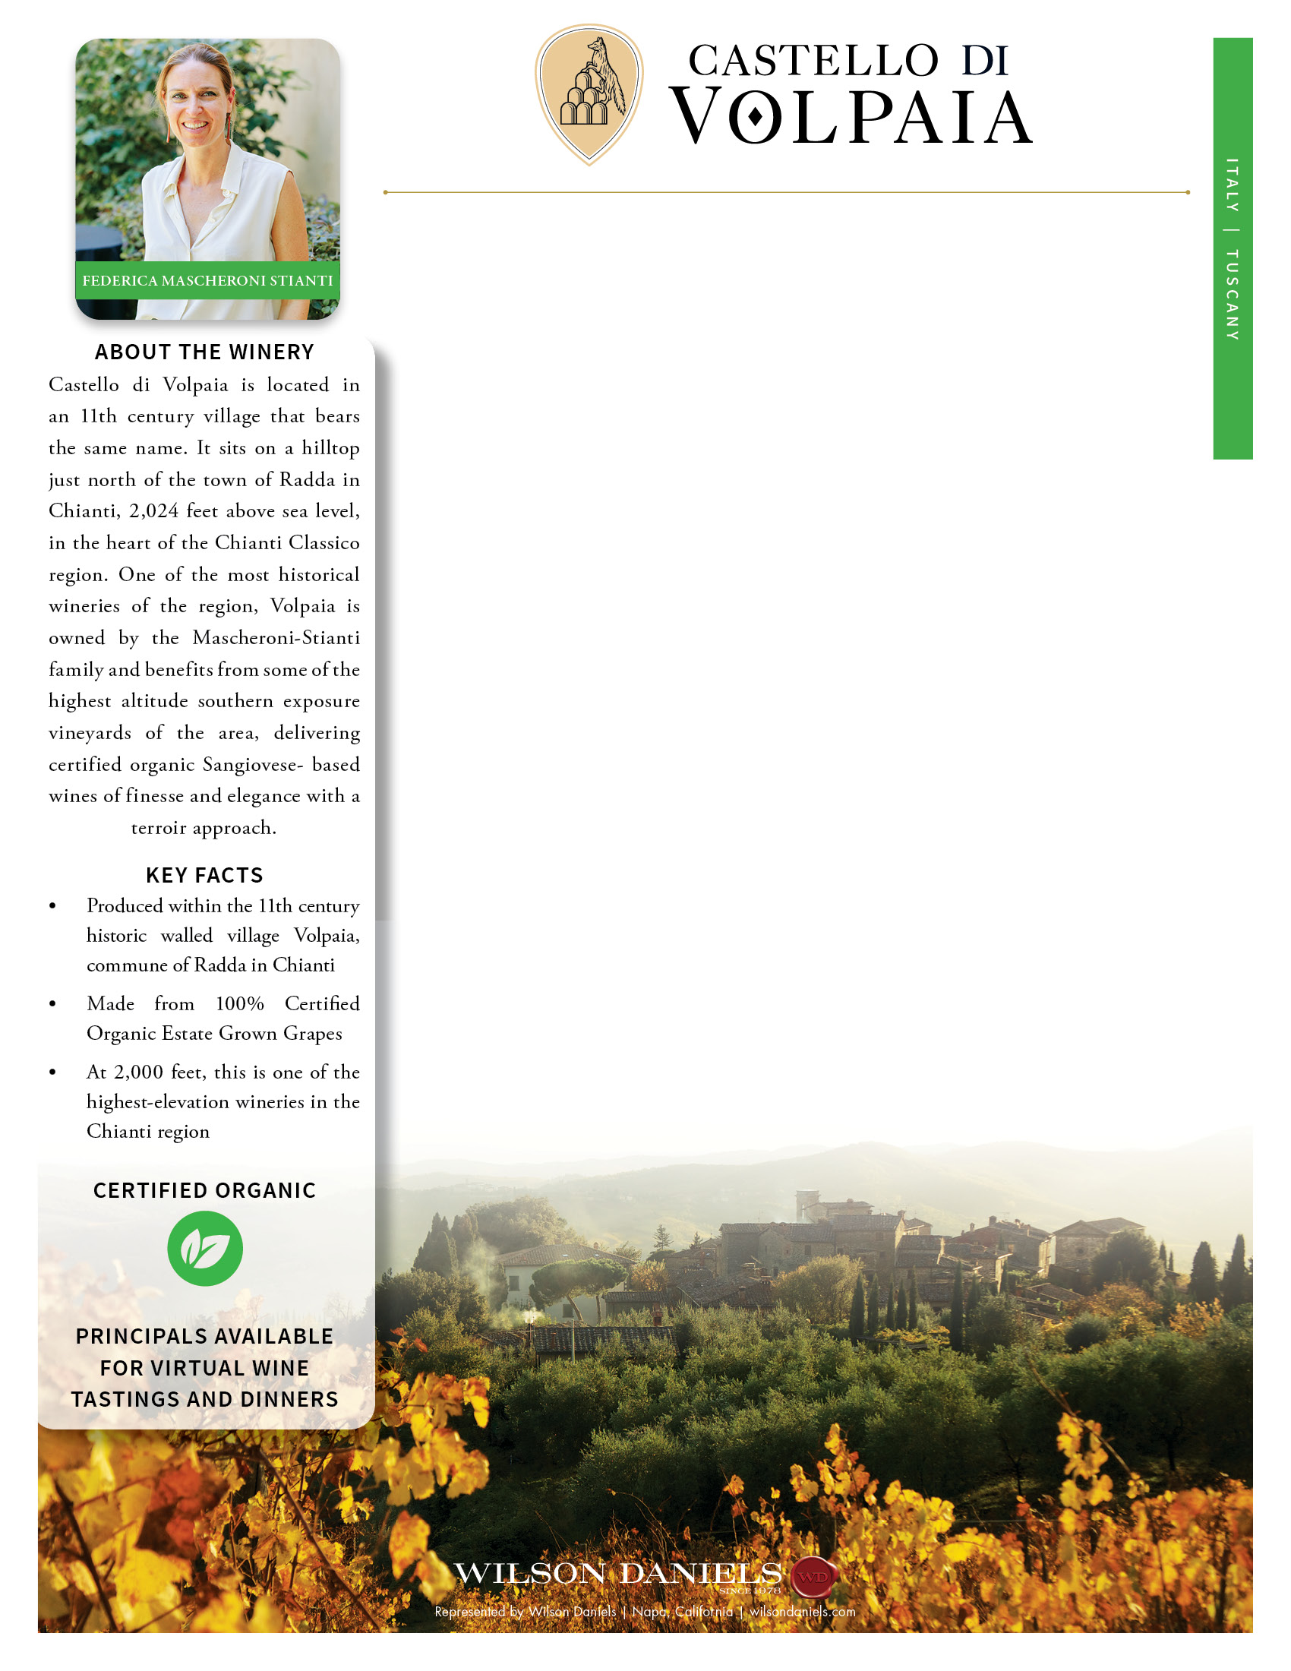
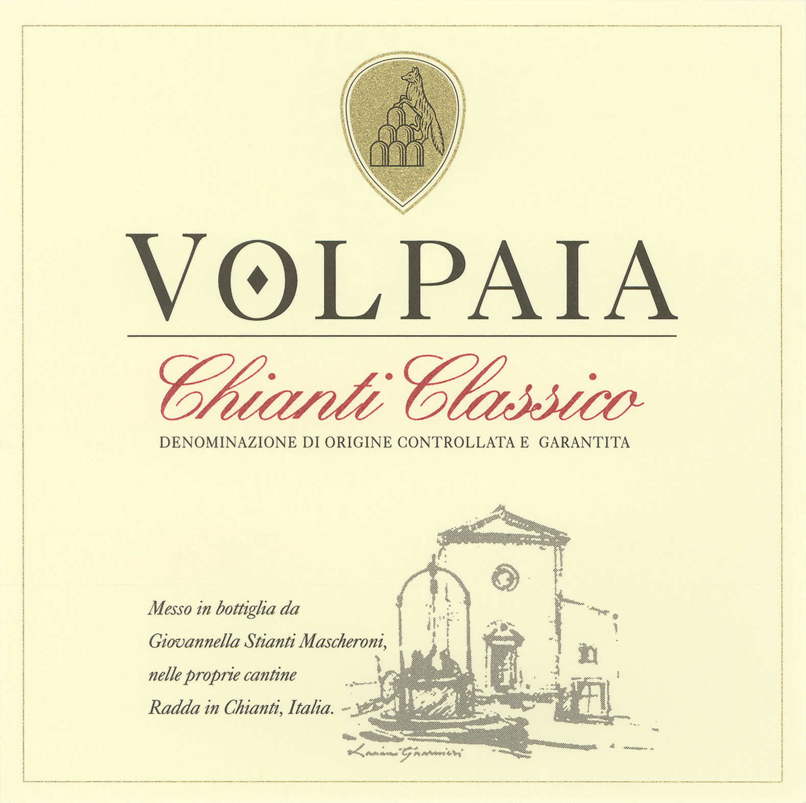
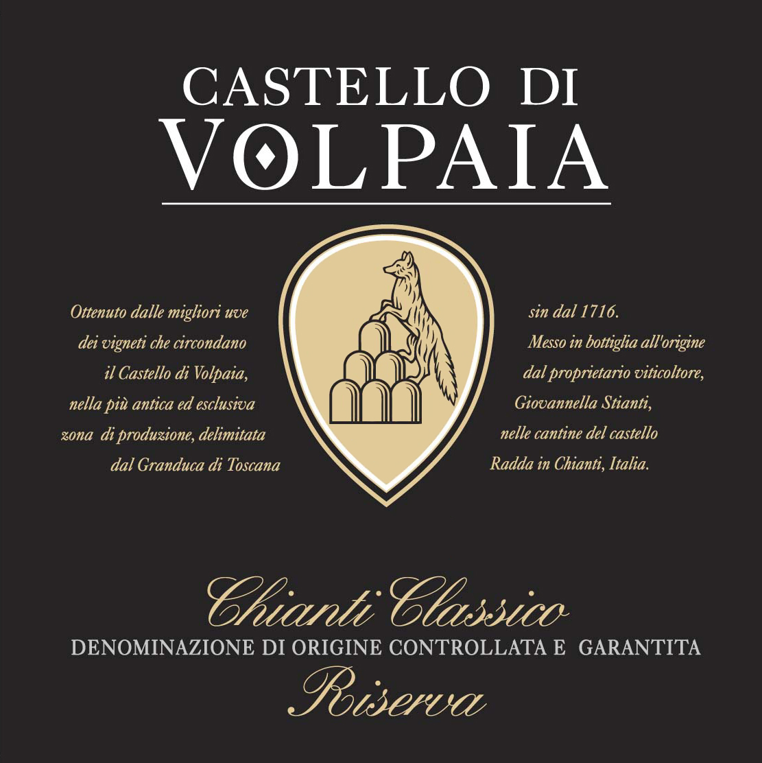
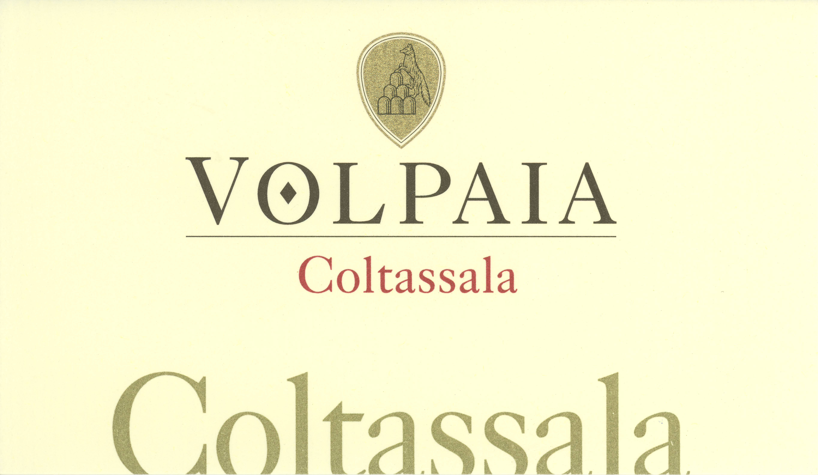
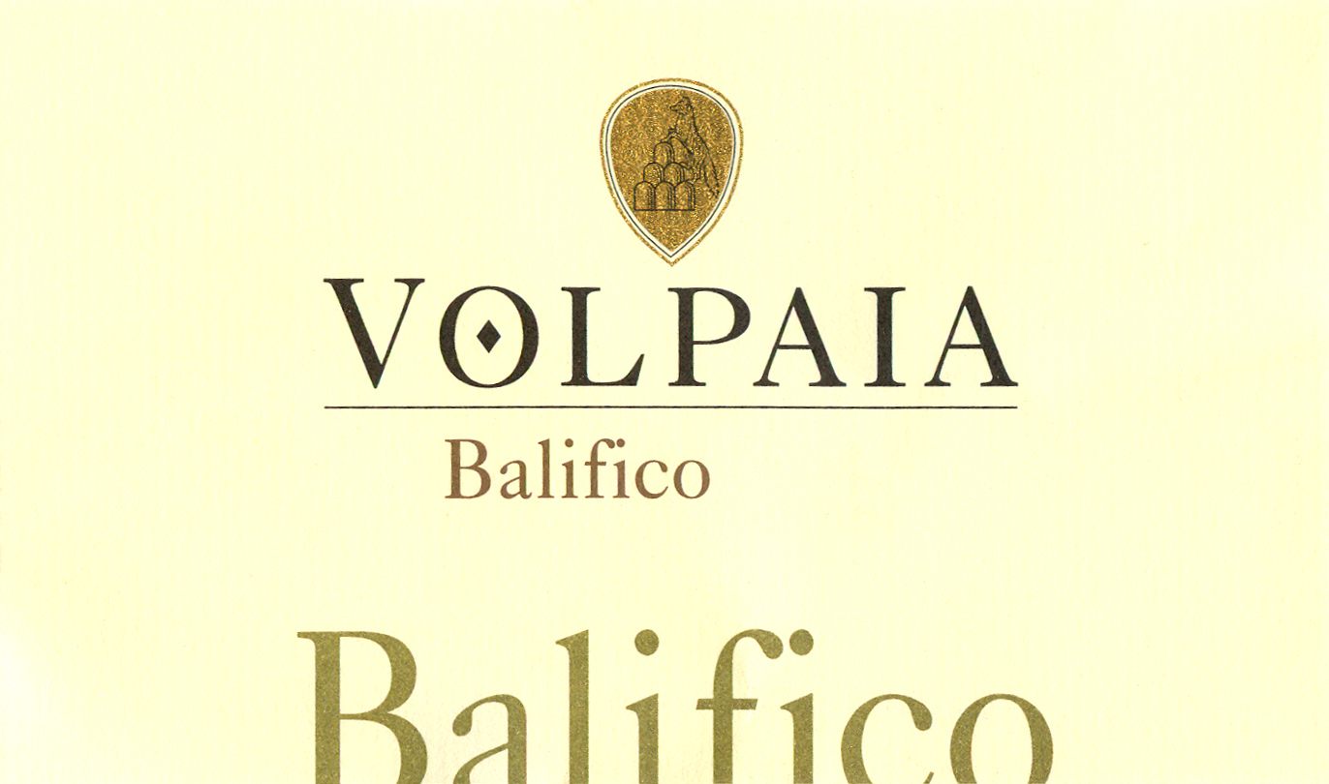
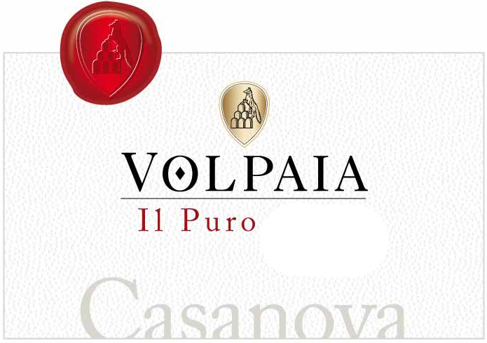
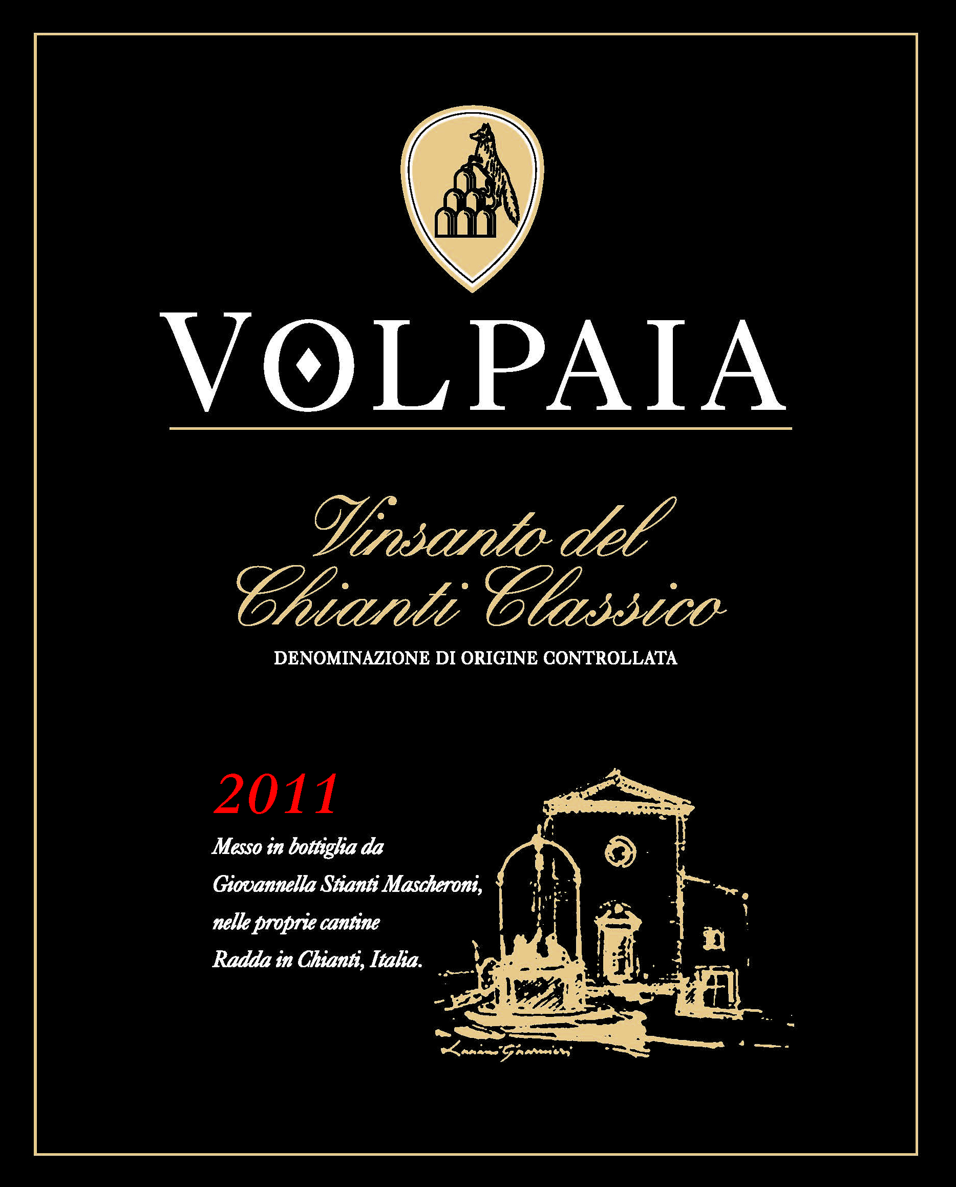
WINES IN INVENTORY
CHIANTI CLASSICO DOCG
Varietal Composition: 90% Sangiovese, 10% Merlot
Vintage | Pack Size | Price | Score
CHIANTI CLASSICO RISERVA DOCG
Varietal Composition: 100% Sangiovese
Vintage | Pack Size | Price | Score
CHIANTI CLASSICO DOCG
Varietal Composition:
Vintage | Pack Size | Price | Score
Coltassala, Chianti Classico Riserva Gran Selezione DOCG – Single Vineyard
Varietal Composition: 95% Sangiovese, 5% Mammolo
Vintage | Pack Size | Price | Score
Balifico, Toscana IGT – Single Vineyard
Varietal Composition: 65% Sangiovese, 35% Cabernet Sauvignon
Vintage | Pack Size | Price | Score
Vintage | Pack Size | Price | Score
IL PURO, CHIANTI CLASSICO GRAN SELEZIONE DOCG – SINGLE VINEYARD
Varietal Composition: 100% Sangiovese
Vintage | Pack Size | Price | Score
Vinsanto del Chianti Classico DOC
Varietal Composition: Trebbiano, Malvasia Bianca del Chianti
Vintage | Pack Size | Price | Score

